Slide 1
The Expanded Learning Partnership
Between the Simpson County Schools and the Boys and Girls Club of Franklin

Slide 2
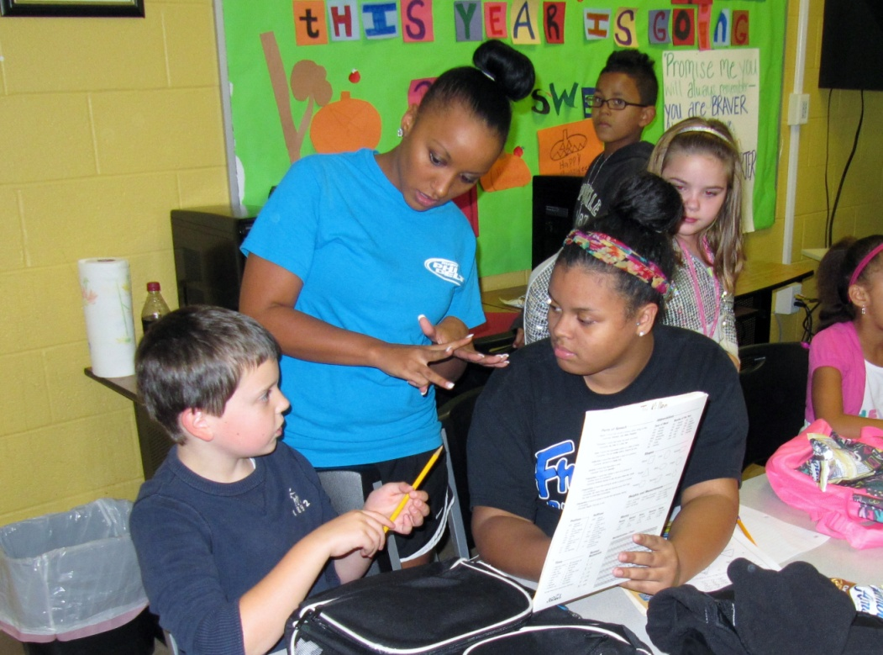
The Expanded Learning Partnership
Jim Flynn, Superintendent
NKU Doctoral Cohort
October 19, 2012

Slide 3
The Expanded Learning Partnership
Approved by the Simpson County Board of Education in December 2011
The Boys and Girls Club of Franklin serves more than 200 kids per day most of whom are in grades K-6

Slide 4
The Expanded Learning Partnership
We employed 2 certified teachers to serve as program coordinators
We employed 8 peer tutors to work with the students Mondays through Thursdays each week
The budget for the project was less than $6,000 for February through May

Slide 5
The Expanded Learning Partnership
The program provided over 45 days of support during the Spring semester
3rd graders were selected as the test group due to the sample size (n=31)
A demographically similar, randomly selected control groups was identified (n=31) made up of 3rd graders who did not attend the Boys and Girls Club

Slide 6
The Expanded Learning Partnership
MAP results in reading and math were used from the Fall and Spring assessments
The program emphasized reading achievement as its primary goal

Slide 7
The Expanded Learning Partnership
The hypothesis stated the program would enhance the achievement of the students in the classroom as measured by the MAP test.
Fall and Spring results were compared in the study between the treatment and control groups

Slide 8
The Expanded Learning Partnership
The Quantitative Results
3rd Grade - Reading | Fall | Spring | Difference
Test Group | 186.3 | 195.0 | 8.7
Control Group | 192.0 | 199.9 | 7.9
National Norm | 189.9 | 199.2 | 9.3
3rd Grade - Math | Fall | Spring | Difference
Test Group | 188.6 | 200.9 | 12.3
Control Group | 193.4 | 206.6 | 13.2
National Norm | 192.1 | 203.1 | 11.0

Slide 9
The Expanded Learning Partnership
Hypothesis test results: |  |  | FALL READING TREATMENT VS. CONTROL
μ₁ : mean of fall treatment group
μ₂ : mean of fall control group
μ₁ - μ₂ : mean difference
H₀ : μ₁ - μ₂ = 0
H_{A} : μ₁ - μ₂ ≠ 0
(without pooled variances)
Difference | Sample Mean | Std. Err. | DF | T-Stat | P-value
μ₁ - μ₂ | -5.70967 | 3.79393 | 56.2392 | -1.50494 | 0.1379
 |  |  |  |  | Not Significant
Comparing the Fall reading results from the treatment group with the control group using a T-stat test produced a P-value of 0.1379 which demonstrates the difference in results are not statistically significant.

Slide 10
The Expanded Learning Partnership
Hypothesis test results: |  |  | SPRING READING TREATMENT VS. CONTROL
μ₁ : mean of spring treatment group
μ₂ : mean of spring control group
μ₁ - μ₂ : mean difference
H₀ : μ₁ - μ₂ = 0
H_{A} : μ₁ - μ₂ ≠ 0
(without pooled variances)
Difference | Sample Mean | Std. Err. | DF | T-Stat | P-value
μ₁ - μ₂ | -4.93548 | 3.15371 | 57.9041 | -1.56497 | 0.123
 |  |  |  |  | Not Significant
Though the treatment group grew more over the year in reading, comparing the Spring reading results from the treatment group with the control group using a T-stat test produced a P-value of 0.123. This demonstrates the difference in results are not statistically significant.

Slide 11
The Expanded Learning Partnership
Hypothesis test results: |  |  | FALL MATH TREATMENT VS. CONTROL
μ₁ : mean of fall treatment group
μ₂ : mean of fall control group
μ₁ - μ₂ : mean difference
H₀ : μ₁ - μ₂ = 0
H_{A} : μ₁ - μ₂ ≠ 0
(without pooled variances)
Difference | Sample Mean | Std. Err. | DF | T-Stat | P-value
μ₁ - μ₂ | -4.74193 | 3.03500 | 59.6196 | -1.56242 | 0.1235
 |  |  |  |  | Not Significant
Comparing the Fall math results from the treatment group with the control group using a T-stat test produced a P-value of 0.1235 which demonstrates the difference in results are not statistically significant.

Slide 12
The Expanded Learning Partnership
Hypothesis test results: |  |  | SPRING MATH TREATMENT VS. CONTROL
μ₁ : mean of spring treatment group
μ₂ : mean of spring control group
μ₁ - μ₂ : mean difference
H₀ : μ₁ - μ₂ = 0
H_{A} : μ₁ - μ₂ ≠ 0
(without pooled variances)
Difference | Sample Mean | Std. Err. | DF | T-Stat | P-value
μ₁ - μ₂ | -5.70967 | 2.79170 | 59.9518 | -2.04523 | 0.0452
 |  |  |  |  | Significant
Interestingly, comparing the Spring math results from the treatment group with the control group using a T-stat test produced a P-value of 0.0452 which demonstrates the control group growth was statistically significant.

Slide 13
The Expanded Learning Partnership
Anecdotal evidence listening to teachers and peer tutors indicated a high level of success in the program
A qualitative study was conducted to investigate this further.
8 questions were used to interview 5 peer tutors and 1 teacher about the impact of the program.
The Qualitative Results

Slide 14
The Expanded Learning Partnership
The Questions:
Do you think the Expanded Learning Partnership with the Boys and Girls Club has an academic benefit to the students who participate?
What was the impact on reading specifically? What was the evidence?
What was the impact on math specifically? What was the evidence?
What non-academic benefits occurred as a result of the program? Evidence?

Slide 15
The Expanded Learning Partnership
The Questions:
What specific strategies did you use to improve reading?
What specific strategies did you use to improve math?
What changes are being made to the program to increase its effectiveness?
Do you recommend this program to continue? Why?

Slide 16
The Expanded Learning Partnership
CONCLUSIONS:
The quantitative results do not show a significant statistical difference on the MAP test in the performance of the treatment group compared to the control group.

Slide 17
The Expanded Learning Partnership
Variables that may have influenced the quantitative results include:
The length of the treatment period was relatively short
The regularity of attendance is not known
The use of peer tutors may limit effectiveness due to lack of training and experience

Slide 18
The Expanded Learning Partnership
The qualitative results indicate a strong belief among the peer tutors and the teacher in the programs positive impact on the students served.
They also believe they have made adjustments that will improve the academic impact as measured by a standardized reading and math assessment.

Slide 19
The Expanded Learning Partnership
This year, we have expanded the program using rural education funds to provide 2 teacher coordinators and 12 peer tutors for the entire year.
The community has embraced this partnership with excitement and deep appreciation

